Slide 1
TIMELY: Pushing Data Movements and Interfaces in PIM Accelerators Towards Local and in Time Domaine
Weitao Li, Pengfei Xu, Yang Zhao, Haitong Li, Yuan Xie, Yingyan Lin
Rice University, Stanford University, University of California
ISCA2020

Slide 2
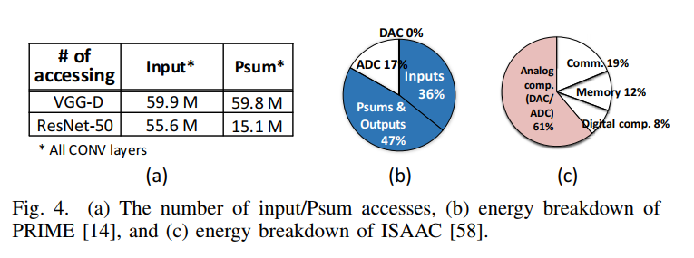
Tow bottle necks
The energy cost of data movements due to inputs and Psums (Partial sums)
The energy of the interfacing circuits (ADC & DAC)

Slide 3
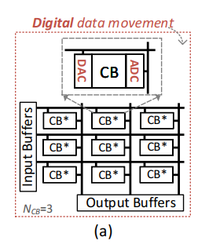
Opportunities
1. Enhancing (analog) data locality to greatly reduce the energy/time costs of both data movements and D/A and A/D interfaces.
2. Time-domain interfacing can reduce the energy cost of a single D/A (and A/D) conversion.
3. Reducing the number of input accesses can save the energy cost of both input accesses and D/A conversions.

Slide 4
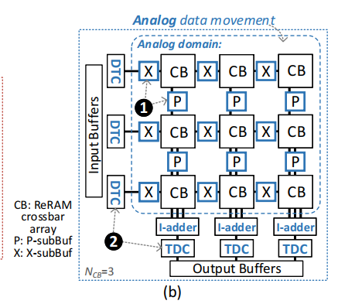
Innovations
1. TIMELY adopts ALBs to aggressively enhance (analog) data locality
2. TIMELY adopts TDIs and ALBs to minimize the energy cost of a single conversion and the total number of conversions, respectively.
3. TIMELY employs O2IR to further reduce the number and thus energy cost of input accesses and D/A conversions. As accessing the input and output buffers in subChips costs

Slide 5
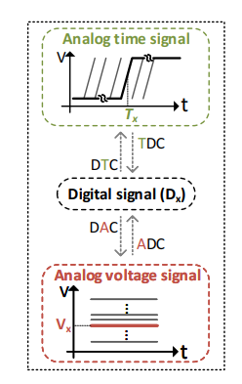
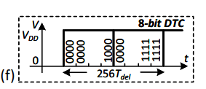
Time signal
Digital signal is presented by time delay with a fixed high-low voltage in time domain.
50x and 20x energy saving compared to ADC and DAC

Slide 6
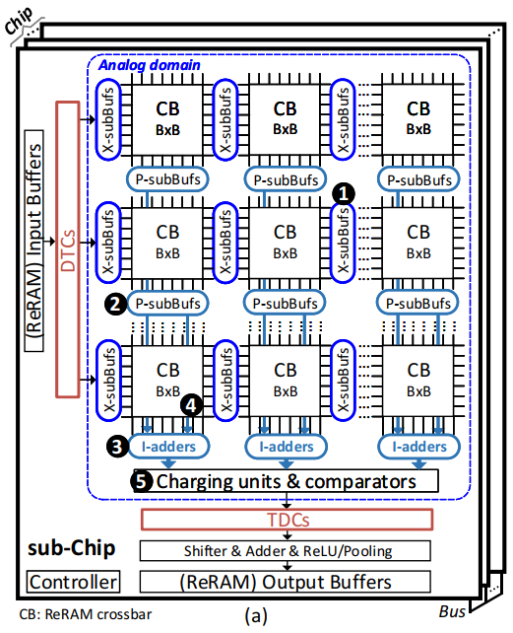
Architecture Overview
Data Path:
Pre-load weights
Fetch inputs into Input Buffer
DTCs (shared by xbars on same row)
Dot-product
Aggregate Psums in I-adders
Charging units & comparators (convert to time signal)
S+A, ReLU, Pooling
Output Buffer

Slide 7
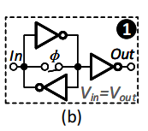
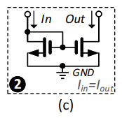
Enhancing (Analog) Data Locality
Inputs move horizontally across the ReRAM crossbar arrays in the same row via X-subBufs
Resulting current Psums move vertically via P-subBufs
X-subBufs & P-subBufs

Slide 8
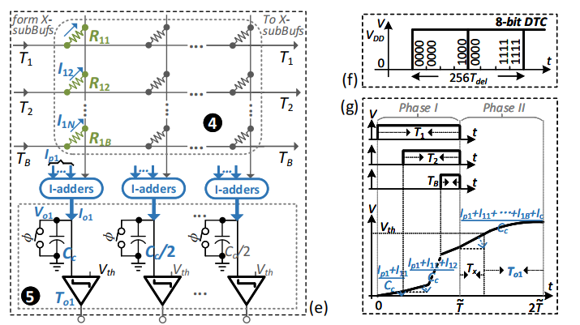
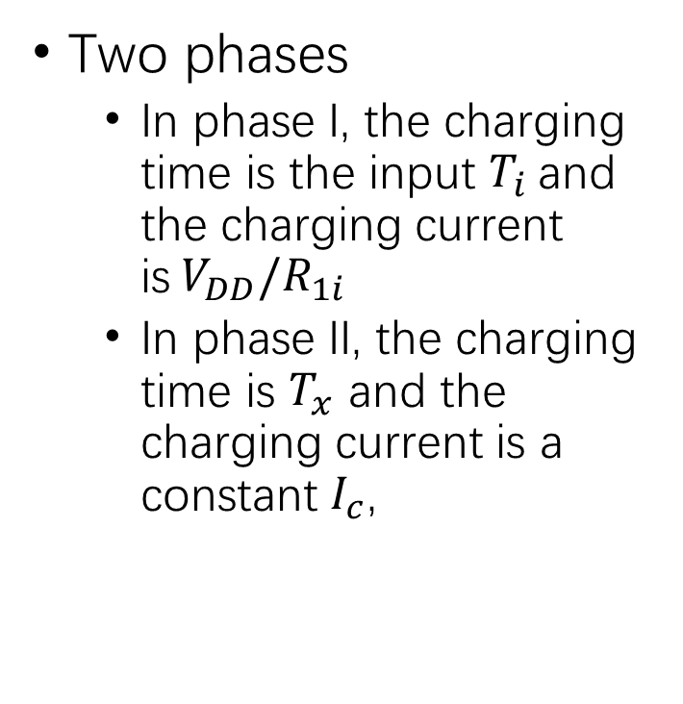
Dot-products in time domain
Two phases
In phase I, the charging time is the input $T_{i}$and the charging current is$V_{DD}/R_{1i}$
In phase II, the charging time is $T_{x}$ and the charging current is a constant $I_{c}$,

Slide 9
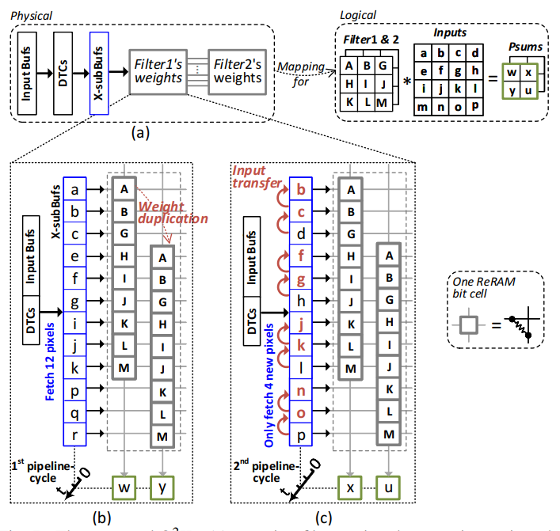
Only-Once Input Read (O2IR)
(1) for reusing the inputs by different filters
(2) for reusing the inputs when sliding the filter vertically within an input feature map,
(3) for reusing the inputs when sliding the filter horizontally within an input feature map

Slide 10
Discuss
Trade off between energy efficiency and accuracy
1. Choose time signal to minimize potential error
2. Number of analog buffer (ALB):
More ALBs: higher accuracy & higher energy consumption
3. Number of P-subBufs:
More
P-subBufs: higher accumulation noise & higher energy consumption

Slide 11
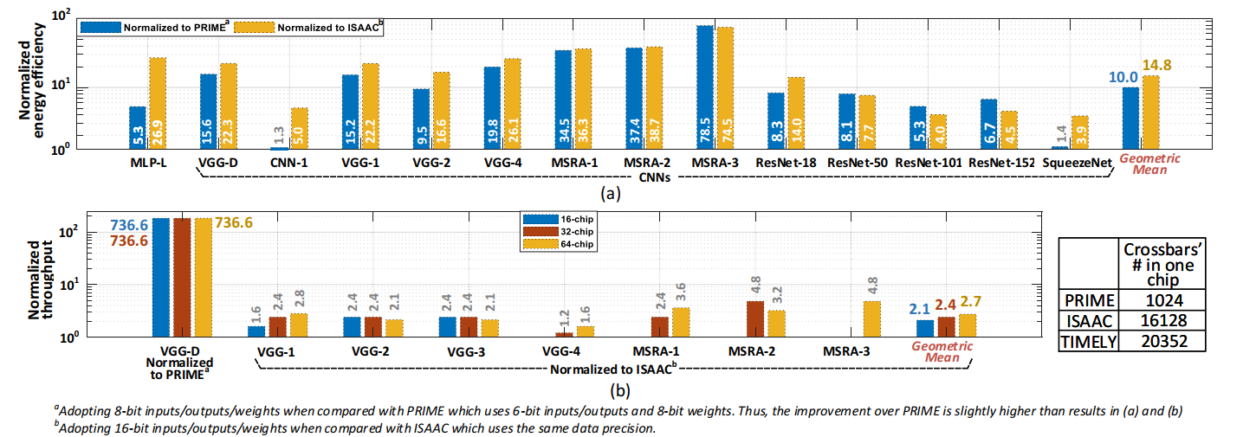
Evaluation
Performance

Slide 12
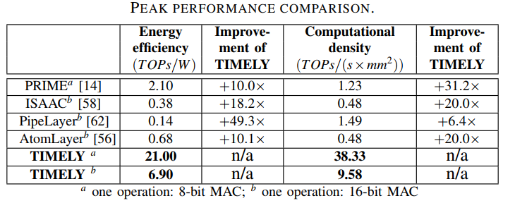
Evaluation
Performance

Slide 13
Evaluation
Accuracy:
<0.1% loss

Slide 14
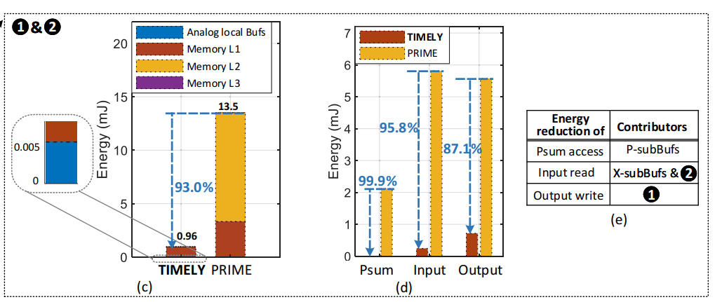
Evaluation
Effectiveness of TIMELY’s Innovations ABL & O2IR

Slide 15
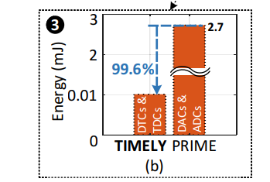
Evaluation
Effectiveness of TIMELY’s Innovations TDI

Slide 16
Thoughts
Time domain Interface
Each sub-Chip is equivalent to one large crossbar
No need for OU
Smaller CNN layers ?
Organization

